Slide 1
REQUEST LOG

Slide 2
REQUEST LOGS
Request logs area record of the requests that the server has processed.
There is only entry per request received,and commonly in the standard NCSA format.
We can use tools like webalizer to analyze them conveniently.

Slide 3
INTRODUCTION TO TABLEAU
Tableau Software is an American computer software company headquartered in Seattle, WA, USA. It generates interactive data visualization products which focused on BI.
By using tableau we can generate graphs which represents the data of the particular system

Slide 4
URL/RECORDS
ANALYSIS : As the number of record increases,load also increases.Therefore pagerank increases
PREDICTION:More chance of system getting hanged while accessing the URL /images/NASA-logosmall.gif.Hence more security concerns.

Slide 5
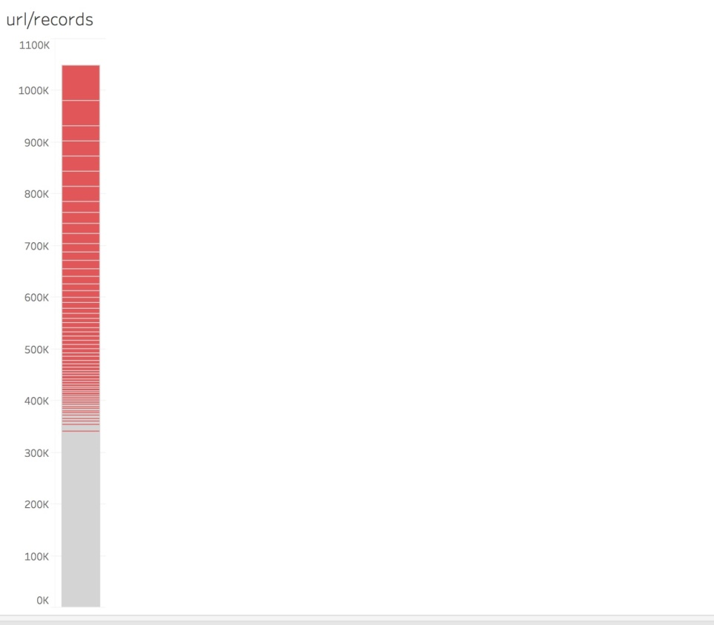

Slide 6
TIIME/METHOD
ANALYSIS : Most of the users use GET method,limited no. of users use POST method and moderate no.of users use HEAD method
Users take large amount of time to retrieve data and less amount of time to post the data
PREDICTIONS:Distributing the data on different servers so that load balancing is made.
When multiple users work on same method,there is possibility of radio jamming.
Hence appropriate measures should be taken.

Slide 7
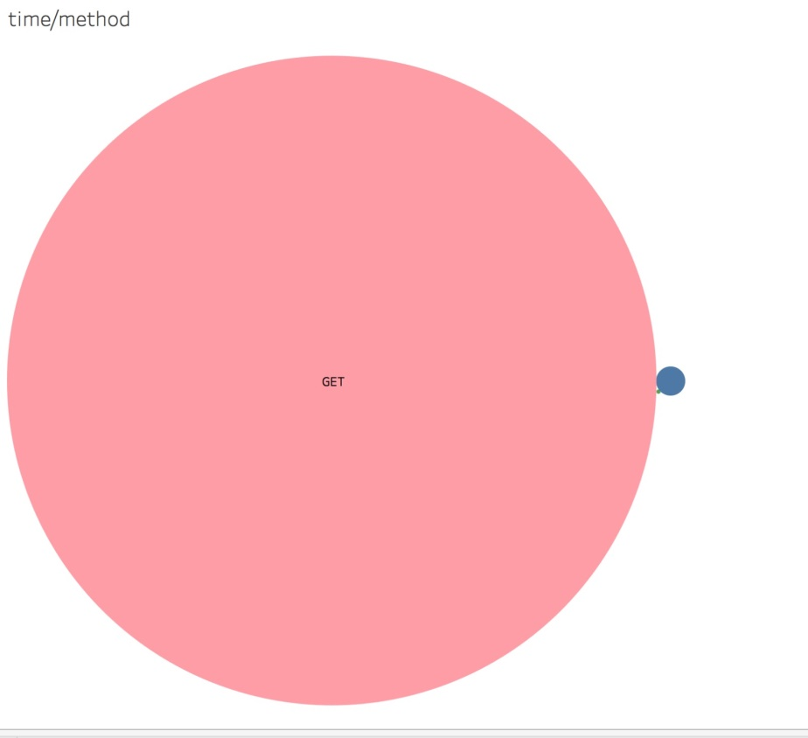

Slide 8
RECORDS/RESPONSE
ANALYSIS:As the no. of responses for given records increases,error rate increases.
There will be more no. of errors for a given record.So efficiency, and stability decreases.
PREDICTIONS:As the error rate increases ,there is a chance of instability of the system.
As the error rate increases,data rate also increases.So chance of noise and disturbances may occur

Slide 9
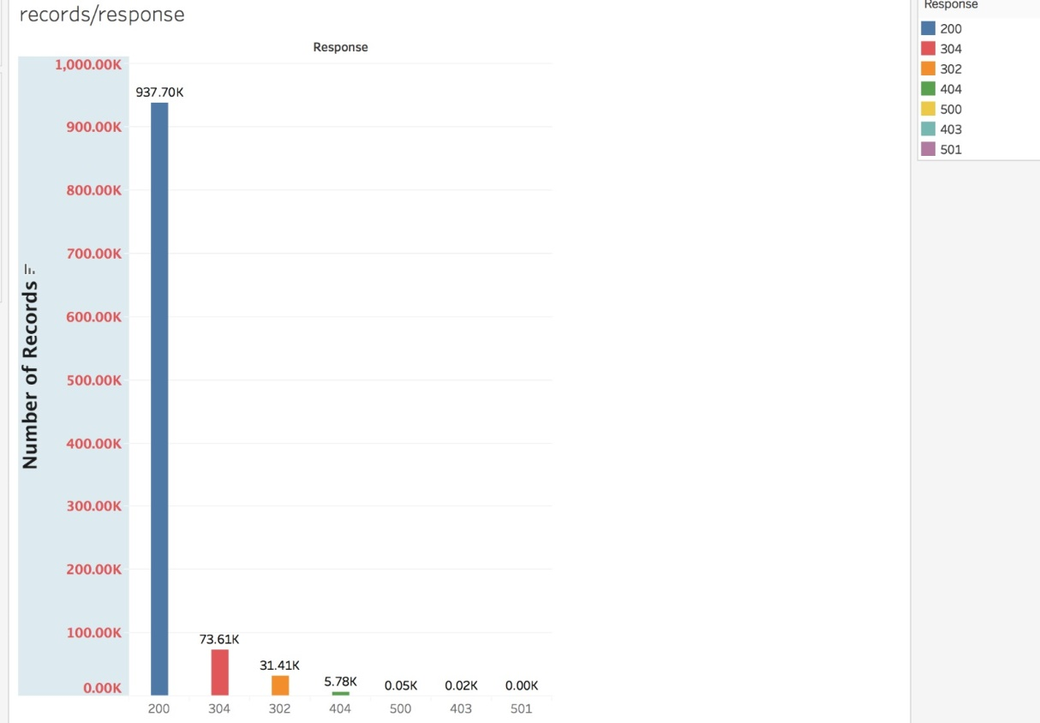

Slide 10
REQUESTS PER DAY
ANALYSIS:Weekends(sat,sun) are on: (1,2), (8,9), (15,16),(22,23) . The number of requests/day on weekends is approximately half the number of requests/day on weekdays. So the load is less on weekends and it increases on weekdays.
PREDICTION :So we can predict that in future also, the load will be high on weekdays and low on weekends.

Slide 11
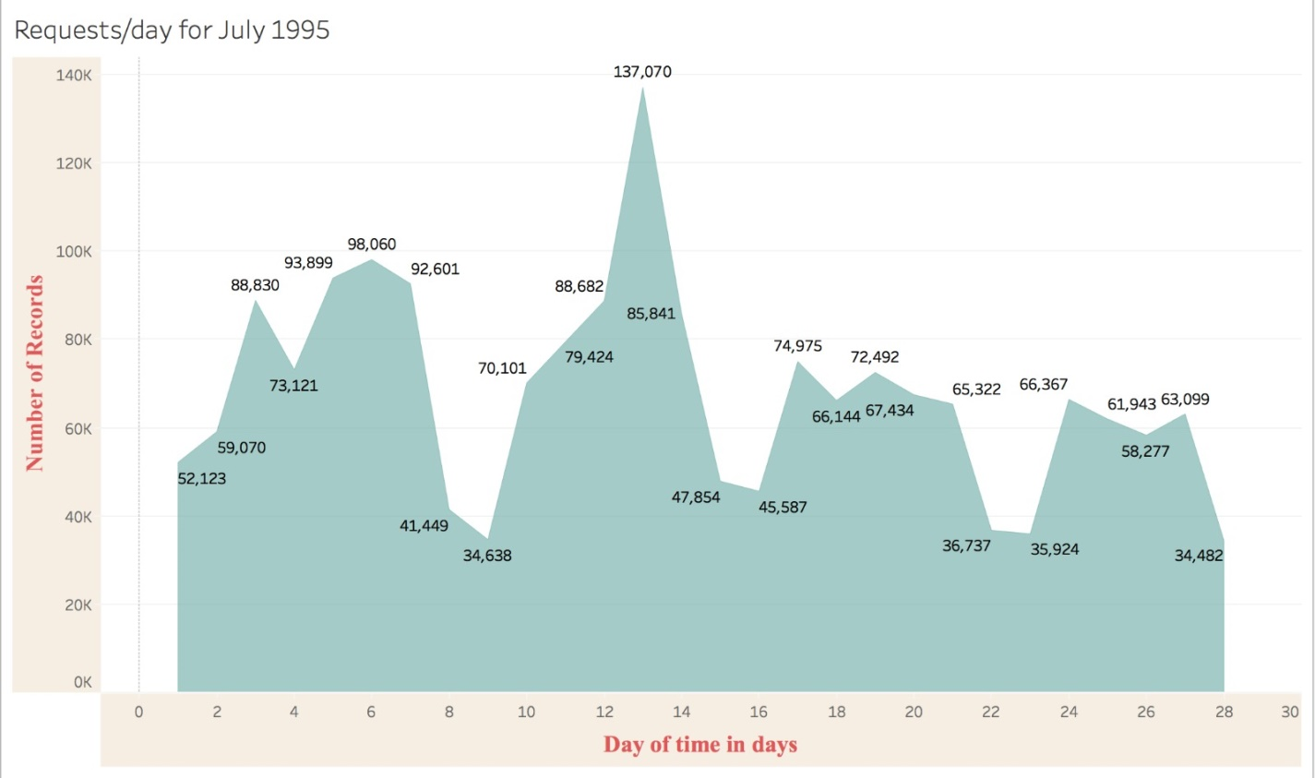

Slide 13
URLS FOR RESPONSE 500
ANALYSIS:Number of records with status code 500:The total number of requests for which we received status code 500 is 65.
PREDICTION:Copy that URL from the link which has 53 records and paste. So there might be some problem in the logic of this API. So if we start bug fixing, then this API mist be fixed on priority

Slide 14
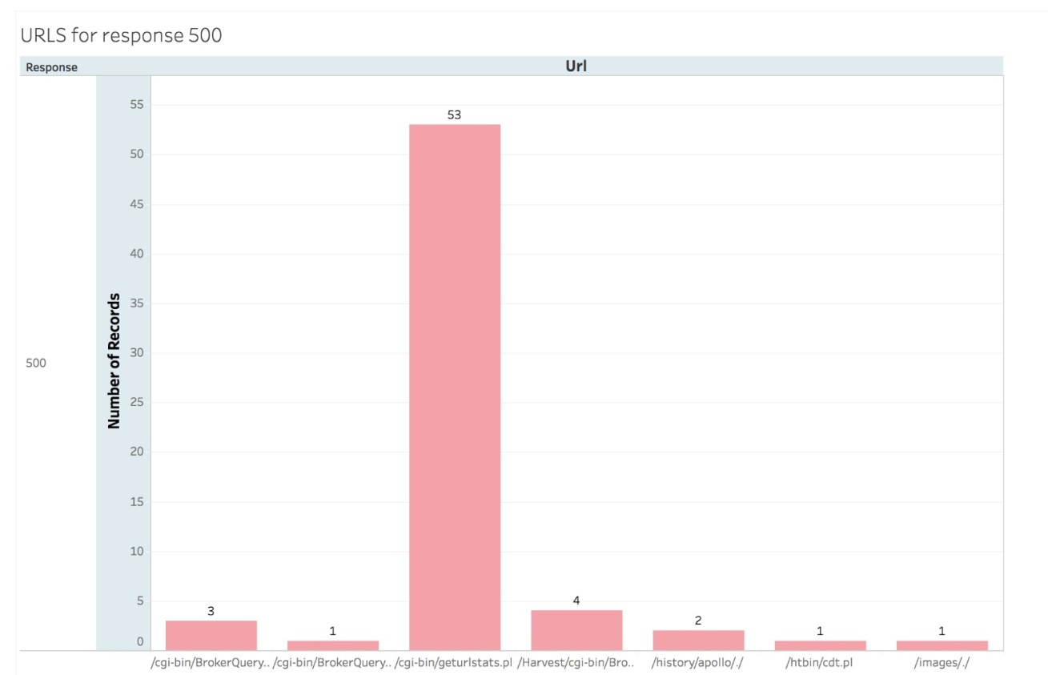

Slide 15
METHOD/BYTES
ANALYSIS: The number of bytes for getting the data by the user are more when compared to remaining methods like post,head.
User does’t use the post method in this scenario
PREDICTIONS:As more no.of bytes are used for post method,there will be more memory used for processing the data.
Hence there will be a mpact on CPU usage time and application time.
Memory shortage and leaks leads to instability.So we need to optimize garbage collection.

Slide 16
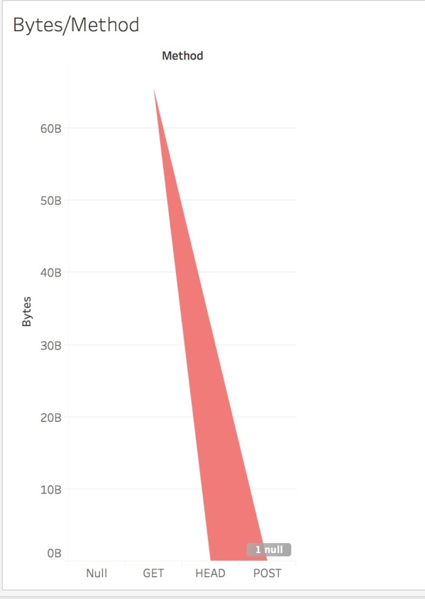

Slide 17
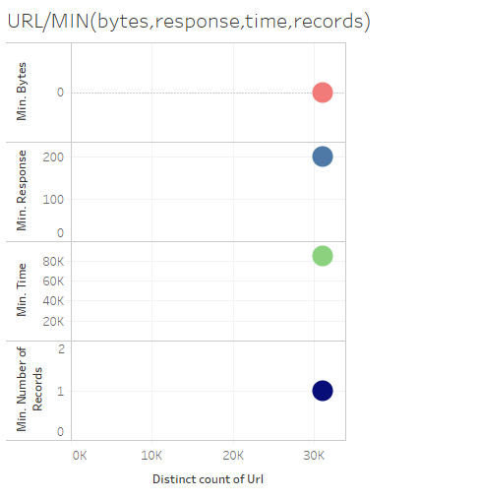
URL/MINIMUM(bytes,time,response,no of records used)

Slide 18
URL/MINIMUM(bytes,time,response,no of records used)
ANALYSIS: This graph clearly shows the minimum(bytes),minimum(time),minimum(records) and minimum(responses) used by the url's.
The total number of url's is 31060.
The min number of bytes used by the url's is 0.
The min time taken by the url's is 80,905 ms.
The min no of responses is 200.
The minimum no of records used by url's is 1.

Slide 19
CONCLUSION
This is all about the web log file, its contents, its types, its location etc. Added to these information it also gives a detailed description of how the file is being processed in the case of web usage mining process.
The various mechanisms that performs each step in mining the log file is being discussed along with their disadvantages.
The additional parameters that can be considered for Log file entries and the idea in creating the extended log file is also discussed briefly.
The extended work is to combine the concept of learning the users area of interest.

